Slide 1
covid-eeraModel: general description EPIC / Roslin Institute /EERA: Thibaud Porphyre, Mark Bronsvoort; UKAEA: Peter Fox Scottish COVID-19 Response Consortium, RAMP
Age-structured, compartment stochastic model (based on ASF within herd model)
COVID19 specific
HCW separated population
Coupled with ABC-smc inference framework
Fit on reported cases and reported mortality data
Fit on national, regional or health board level
C++

Slide 2
Purpose of the model
Short-term goals:
inference of key epidemiological parameters
changes between scales UK vs Scotland vs health board
Medium-term goals:
Prediction of community level infection
Evaluation impact of various scenarios for lifting movement restrictions
Evaluation impact of various testing regimes

Slide 3
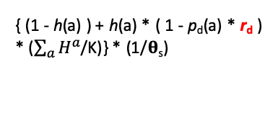
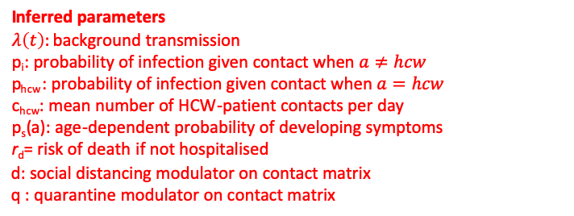
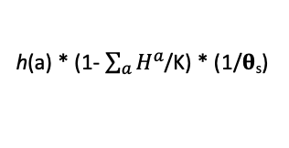
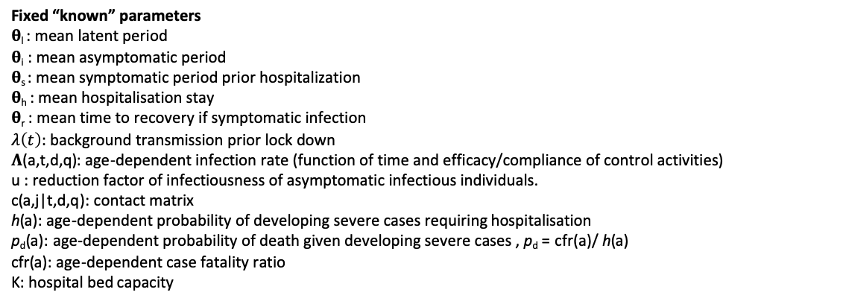
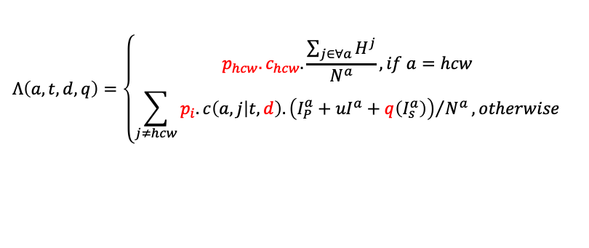
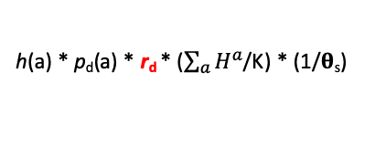
Model structure
Iª
1/𝛉_{r}
Rª
As is in the simpler-framework branch
(1-p_{s}(a))*(1/𝛉_{i})
{ (1 - h(a) ) + h(a) * ( 1 - p_{d}(a) * r_{d} ) * ($\sum_{a}{H^{a}}$/K)} * (1/𝛉_{s})
(1- p_{d}(a) ) * (1/𝛉_{h})
Sª
λ(t) + 𝚲(a,t,d,q)
Eª
I_{P}ª
I_{S}ª
h(a) * (1- $\sum_{a}{H^{a}}$/K) * (1/𝛉_{s})
Hª
1/𝛉_{l}
p_{s}(a)*(1/𝛉_{i})
Transmission rate
h(a) * p_{d}(a) * r_{d} * ($\sum_{a}{H^{a}}$/K) * (1/𝛉_{s})
p_{d}(a)* (1/𝛉_{h})
$$Λ\left(a,t,d,q\right)=\left\{\begin{matrix}p_{hcw}.c_{hcw}.\frac{\sum_{j∈∀a}{H^{j}}}{N^{a}}, if a=hcw \\ \sum_{j≠hcw}{{p_{i}.c\left(a,j | t,d\right).\left({I_{P}^{a}+uI}^{a}+q\left(I_{s}^{a}\right)\right)}/{N^{a}}}, otherwise\end{matrix}\right.$$
Dª
Fixed “known” parameters
𝛉_{l} : mean latent period
𝛉_{i} : mean asymptomatic period
𝛉_{s} : mean symptomatic period prior hospitalization
𝛉_{h} : mean hospitalisation stay
𝛉_{r} : mean time to recovery if symptomatic infection
$λ\left(t\right):$ background transmission prior lock down
𝚲(a,t,d,q): age-dependent infection rate (function of time and efficacy/compliance of control activities)
u : reduction factor of infectiousness of asymptomatic infectious individuals.
c(a,j|t,d,q): contact matrix
h(a): age-dependent probability of developing severe cases requiring hospitalisation
p_{d}(a): age-dependent probability of death given developing severe cases , p_{d} = cfr(a)/ h(a)
cfr(a): age-dependent case fatality ratio
K: hospital bed capacity
Inferred parameters
$λ\left(t\right):$background transmission
p_{i}: probability of infection given contact when $a≠hcw$
p_{hcw}: probability of infection given contact when $a=hcw$
c_{hcw}: mean number of HCW-patient contacts per day
p_{s}(a): age-dependent probability of developing symptoms
r_{d}= risk of death if not hospitalised
d: social distancing modulator on contact matrix
q : quarantine modulator on contact matrix

Slide 4
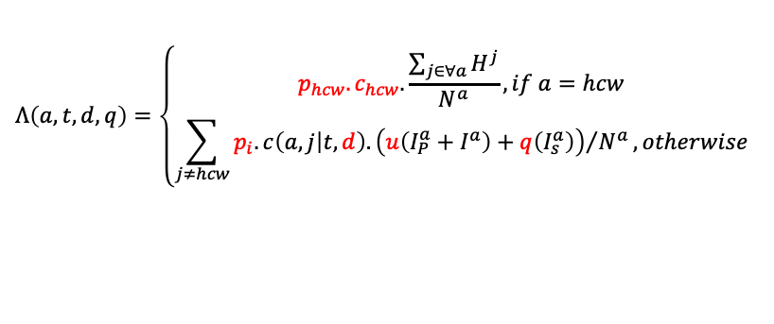
Model structure
8 age/type categories:
7 age classes: Under20, 20-29, 30-39, 40-49, 50-59, 60-69, Over70 yo
1 class for HCW: assumed behaving link 20-59 yo
Transmission is different between community and HCW
Compartment model
Transition of individuals from 1 compartment to another based on Poisson random number (tau-leap)
ISSUE 1: Process is order dependent:
Order from top to bottom
When process occur at the same time: hospitalisation > death > recovery
Time step = 1 day
Decay
Mostly exponential decay
Time to recovery and time to hospitalisation is Erlang-shaped decay function
Succession of 4 (arbitrary) compartments before recovery/hospitalisation
Population structure, age-specific hospitalisation rate and CFRc
Transmission rate
$$Λ\left(a,t,d,q\right)=\left\{\begin{matrix}p_{hcw}.c_{hcw}.\frac{\sum_{j∈∀a}{H^{j}}}{N^{a}}, if a=hcw \\ \sum_{j≠hcw}{{p_{i}.c\left(a,j | t,d\right).\left(u\left({I_{P}^{a}+I}^{a}\right)+q\left(I_{s}^{a}\right)\right)}/{N^{a}}}, otherwise\end{matrix}\right.$$

Slide 5
Implementation
2 seeding strategies
Strat 1: introduce n individual in the I_{P} disease state randomly within one of the 20-70 age groups
Occur once at T days prior detection on index case
Strat 2: introduce Pois(λS) individuals in the E disease state, randomly distributed within the 20-70 age groups (multinomial)
Occur every day for a period from HRP days prior detection on index case and the lock down. Arbitrary used (HRP=34days)
Contact
Informed by WAIFW matrix, i.e. Who Acquires Infection From Whom (asymmetric matrix)
Mean number of contacts between age classes
Implementation of the lockdown
Prior lockdown: full contact matrix
Post lockdown: reduced contact matrix
Mean number of contact between age groups
(source: Prem et al 2017)

Slide 6
Quarantines and social distancing
Quarantines and lockdown are implemented by modulating the average number of contacts informed by the WAIFW matrix
Lockdown is implemented by:
Post lockdown: reduced contact matrix = weighted average between 2 matrices: WAIFW home (home only contacts) and WAIFW lock (total contacts – (work contacts +school contacts) )
(1-s)* WAIFW_lock + s * WAIFW_home
Quarantine is implemented by:
Assume quarantine occurs only for individual in I_{s} state
Assume perfect quarantine from HCW
ISSUE: no household quarantines
Quarantined individuals will have reduced contact to home contacts (WAIFW_home)
Reduction of contacts wrt full contacts changes between post and pre lockdown period
Proportion reduction (1-q) from the mean(WAIFW_home/WAIFW) over all age classes

Slide 7
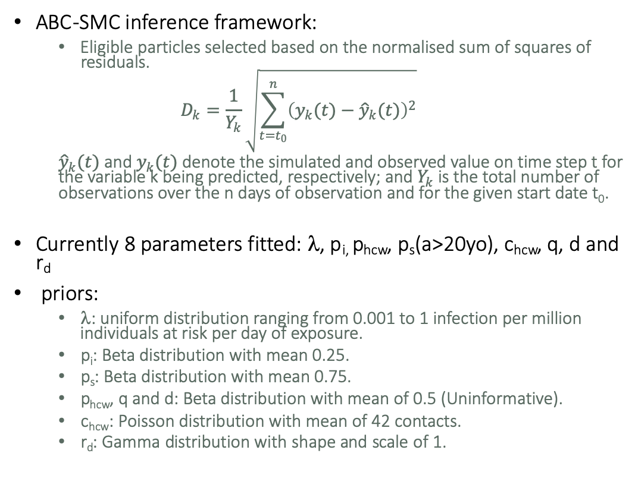
Inference
ABC-SMC inference framework:
Eligible particles selected based on the normalised sum of squares of residuals.
$$D_{k}=\frac{1}{Y_{k}}\sqrt{\sum_{t=t_{0}}^{n}{{\left(y_{k}(t)−{\hat{y}}_{k}(t)\right)}^{2}}}$$
${\hat{y}}_{k}(t)$ and $y_{k}(t)$ denote the simulated and observed value on time step t for the variable k being predicted, respectively; and $Y_{k}$ is the total number of observations over the n days of observation and for the given start date t₀.
Currently 8 parameters fitted: λ, p_{i,} p_{hcw}, p_{s}(a>20yo), c_{hcw}, q, d and r_{d}
priors:
λ: uniform distribution ranging from 0.001 to 1 infection per million individuals at risk per day of exposure.
p_{i}: Beta distribution with mean 0.25.
p_{s}: Beta distribution with mean 0.75.
p_{hcw}, q and d: Beta distribution with mean of 0.5 (Uninformative).
c_{hcw}: Poisson distribution with mean of 42 contacts.
r_{d}: Gamma distribution with shape and scale of 1.

Slide 8
Goodness of fit
K=2000, u=1

Slide 9
Validation (1): death in the community

Slide 10
Validation (2): Community-level proportion of infectious
Proportion of infectious ind. on Apr 28
K=2000, u=1
Community
Epi state distribution on Apr 28
ONS Survey England Apr 27 – May 10
hcw

Slide 11
Validation (3): age distribution

Slide 14
Current status
Basic model is ready
Next Steps
Compare model to others
Require agreed/validated fixed parameters
Fit on overall mortalities (not only from hospital)
Implement predictive ability
Implement testing regime
Documentation

Slide 15
Required improvements
Code:
Peter to list but likely to be a lot

